Slide 1

TRANSFORMERS and natural language processing
Grady Kurpasi
SUNY Binghamton
Termination Project

Slide 2
Overview
Transformers vs RNNs
RNN Limitations
Transformer Improvements
Getting Started
Attention
Self-Attention
Self Attention via Dot Products
Self Attention via Matrices
Transformers
“All You Need is Attention”
Multi-Head Attention
Vaswani et al Transformer
Training
More on Embedding
Hyperspace Vectors
Hyperspace Reduction
New Models
Pre-Trained
BERT
GPT 3
Longformer
Applications
Limitations

Slide 3



Recurrent Neural Networks
Transformers vs RNNs
Up until 2017, RNNs were the premier neural network architecture for processing time-series or sequential data like language
y
y
y
y
y
$$w_{yh}$$
h
$$w_{hh}$$
h
h
h
h
h
$$w_{xh}$$
x
x
x
x
x
t=1 t=2 t=3 t=4

Slide 4
Recurrent Neural Networks
Transformers vs RNNs
Vanishing gradients were a major problem for initial RNN architectures (Versloot 2020)
Recurrent multiplication of small gradients through multiple timesteps causes gradients to ‘vanish’ i.e. approach zero
Vanishing gradients degrade learning on long sequences
Vanishing gradients prevent learning long-distance dependencies
i.e. relationships between distant inputs.
y
y
y
y
h
h
h
h
h
x
x
x
x
t=1 t=2 t=3 t=4
(Versloot 2020)

Slide 5




Recurrent Neural Networks
Transformers vs RNNs
Newer Architectures like Long Short Term Memory (LSTM) remedied vanishing gradients
introduced greater cell complexity at each time step
Added additional gradient path
Supported learning long sequences and long-distance dependencies
y
c_{t-1}
x
+
c
$$w_{yh}$$
x
h
$$w_{hh}$$
x
$$w_{xh}$$
h
h_{t-1}
+
W
x
x

Slide 6
Recurrent Neural Networks
Transformers vs RNNs
y
Despite success all RNNs are inherently sequential in nature
Each timestep must be calculated before a successive timestep can be calculated (Versloot 2020)
because hidden layers must be passed forward
Sequential processing prohibits parallel computing,
e.g. “John”, “hit” and “Fred” cannot be calculated simultaneously
t1
h
h
x
“John”
y
y
t2
h
h
h
x
x
“John” “hit”
y
y
y
t3
h
h
h
h
(Versloot 2020)
x
x
x
“John” “hit” “Fred”

Slide 7
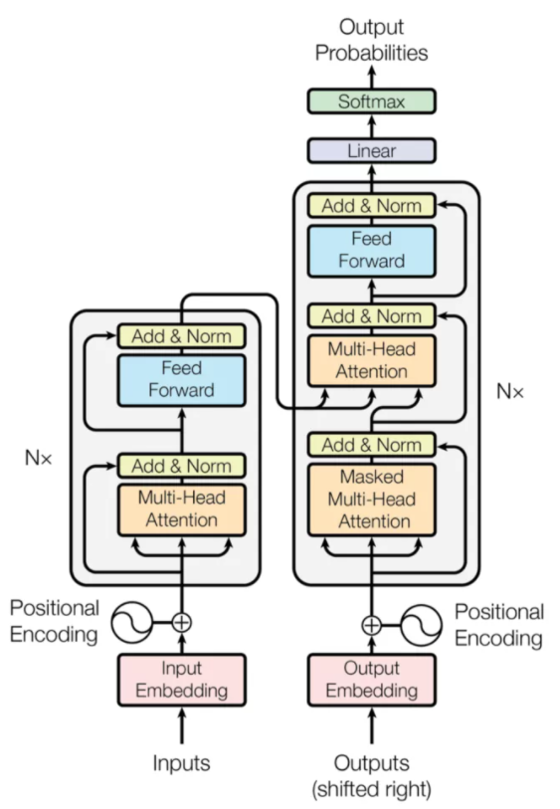
Transformers
Transformers vs RNNs
2017 Vaswani et al publish “Attention is All You Need”
propose “a model architecture eschewing recurrence and instead relying on an attention mechanism to draw global dependencies between input and output” (Vaswani et al 2017)
model forgoes recurrence, sequential hidden layers and convolution
Model relies on “Attention”
(Vaswani et al 2017)

Slide 8
Transformers
Transformers vs RNNs
Model achieved state of the art success in language tasks like automatic translation
Non-sequential nature of the model enabled parallelization
e.g. “John”, “hit” and “Fred” can be processed simultaneously
while retaining sequential context
(i.e. differentiation from “Fred hit John”)
Transformers outperformed RNNs and were computationally cheaper
(Vaswani et al 2017)
(Vaswani et al 2017)

Slide 9

Attention
Getting Started
Transformers are founded on Attention
Attention previously used with neural networks
particularly convolutional neural networks
But had never been primary mechanism
(clipartkey.com)

Slide 10
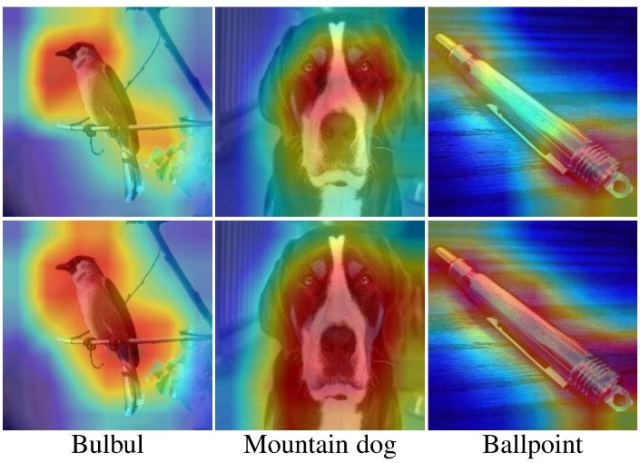
Attention
Getting Started
NN Attention functions like human attention.
NN “attends” to features of a dataset
by masking out irrelevant features
Very successful in computer vision applications
Examples include object identification
As a model trains, it learns what to attend to or not
(paperspace.com)

Slide 11
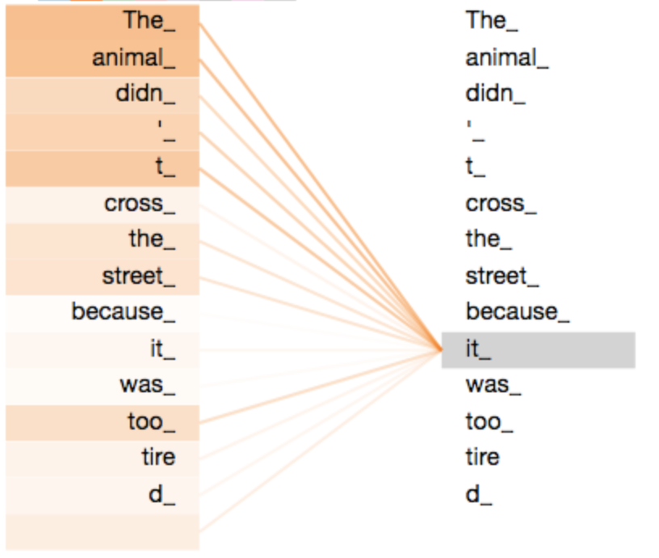
Self Attention
Getting Started
“Relates different positions of a single sequence in order to compute a representation of the sequence”
Relates every input to every other
Determines what to “attend” to
(Vaswani et al 2017)
Heat map
Strength of relationship between
words in a sentence
word ‘it’
(Alammar 2020)

Slide 12
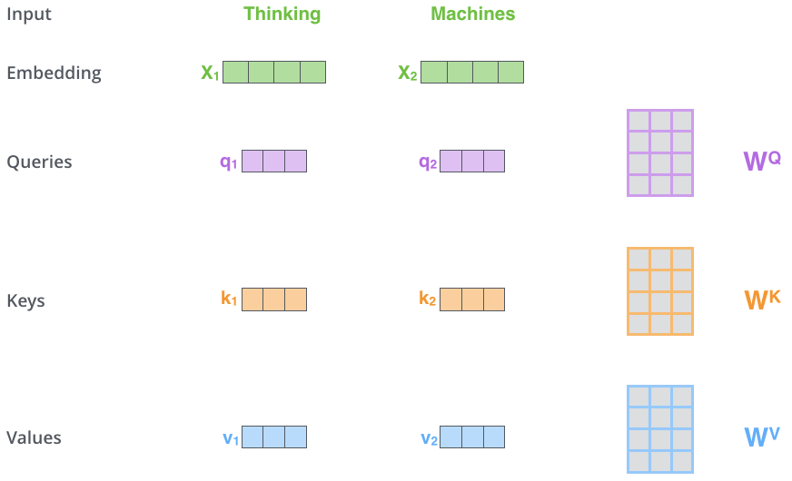
Self-Attention Via Scaled Dot Products
Getting Started
Self Attention can be calculated via dot products
Example:
Input: “Thinking Machines”
sequence length n = 2
(Alammar 2020)

Slide 13
Self-Attention Via Scaled Dot Products
Getting Started
INPUTS
ABSTRACTIONS
Quick Overview
Every input is associated with a key, a query and a value
k, q, v abstract associated input
Every query is ‘run’ against all keys
query-key pairs abstract input-input pairs
query-key pairs generate weights
reflect strength of relationship between inputs
Weights applied to values
Weighted values express how inputs ‘attend’ to each other
x₁
x₂
x₃
…
x_{n}
k₁
q₁
v₁
k_{n}
q_{n}
v_{n}
x₁, … , x_{n}
x_{i}

Slide 14
Self-Attention Via Scaled Dot Products
Getting Started
Each input x is embedded
i.e. translated into a numerical vector
The embedding algorithm is arbitrary
generally encodes both input and environment
e.g. a word and the sentence it occurs in
(Alammar 2020)

Slide 15
Self-Attention Via Scaled Dot Products
Getting Started
Dot Product Attention employs 3 vectors
Key, Query & Value
K, Q, V = Inputs * Weight Matrices
All weight matrices have same dimensions
All k, q, v vectors have same dimension
Allows dot product calculation
Each input has its own k_{x}, q_{x}, v_{x} vectors
(Alammar 2020)

Slide 16
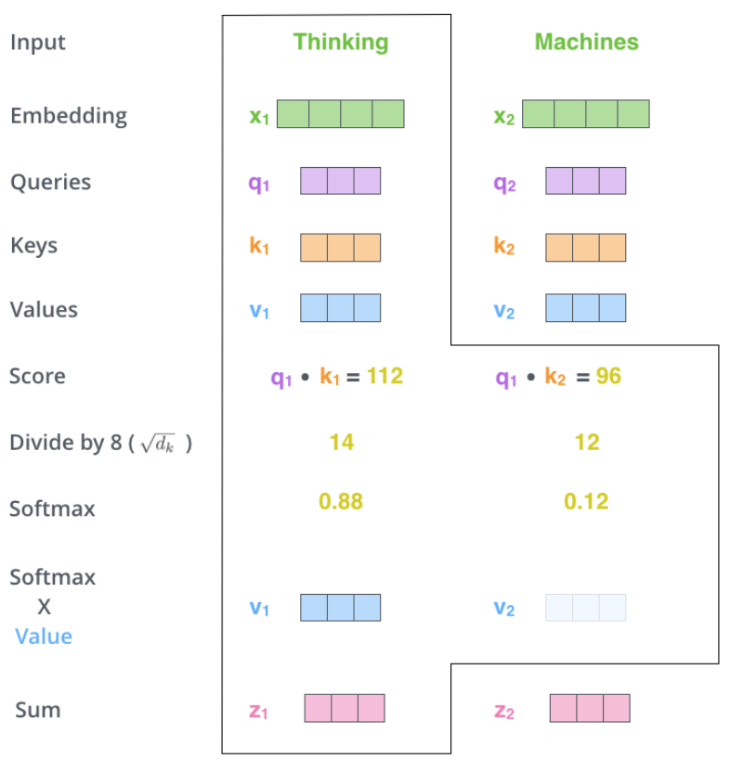
Self-Attention Via Scaled Dot Products
Getting Started
Scores generated from query-key pairs
Score = dot product q_{x} * k_{i} (scalar)
Scores_{x1}
q₁ * k₁, … ,
q₁ * k_{n}
Scores_{x2}
q₂ * k₁, … ,
q₂ * k_{n}
Raw Scores reflect magnitude of correlation between two inputs
Scalar values for illustration only
(Alammar 2020)

Slide 17
Self-Attention Via Scaled Dot Products
Getting Started
All Scores are scaled
(In this example) Scaled Score = Score / 8
Stabilizes gradients
Prevents vector values from exploding
Decreases sensitivity of Softmax
Prevents vanishing gradients
(Alammar 2020)
(Adaloglou 2020)
(Versloot 2020)
(Versloot 2020)
Scalar values for illustration only
(Alammar 2020)

Slide 18
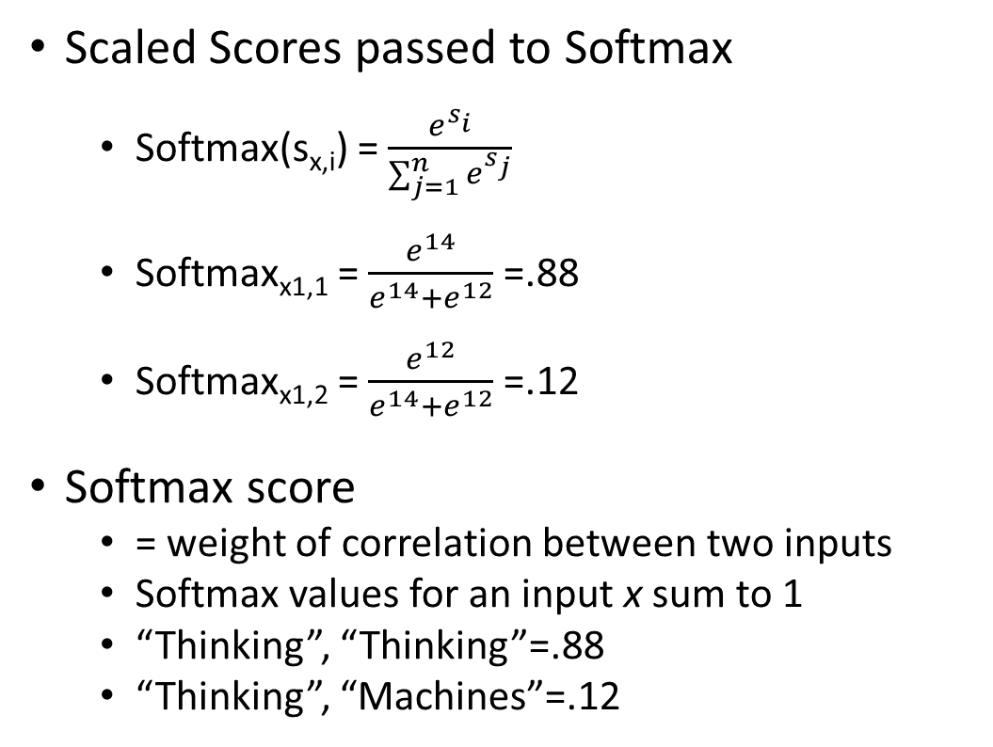
Self-Attention Via Scaled Dot Products
Getting Started
Scaled Scores passed to Softmax
Softmax(s_{x,i}) = $\frac{e^{s_{i}}}{\sum_{j=1}^{n}{e^{s_{j}}}}$
Softmax_{x1,1} = $\frac{e^{14}}{e^{14}+e^{12}}$ =.88
Softmax_{x1,2} = $\frac{e^{12}}{e^{14}+e^{12}}$ =.12
Softmax score
= weight of correlation between two inputs
Softmax values for an input x sum to 1
“Thinking”, “Thinking”=.88
“Thinking”, “Machines”=.12
Scalar values for illustration only
(Alammar 2020)

Slide 19
Self-Attention Via Scaled Dot Products
Getting Started
Weights applied to value vectors
The sum of an input’s weighted value vectors = attention vector z
z expresses how an input attends to other inputs in the current context
z₁ = (.88 * v1) + (.12 * v2)
Attention vector for ‘Thinking’
In context “Thinking Machines”
Scalar values for illustration only
(Alammar 2020)

Slide 20
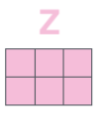
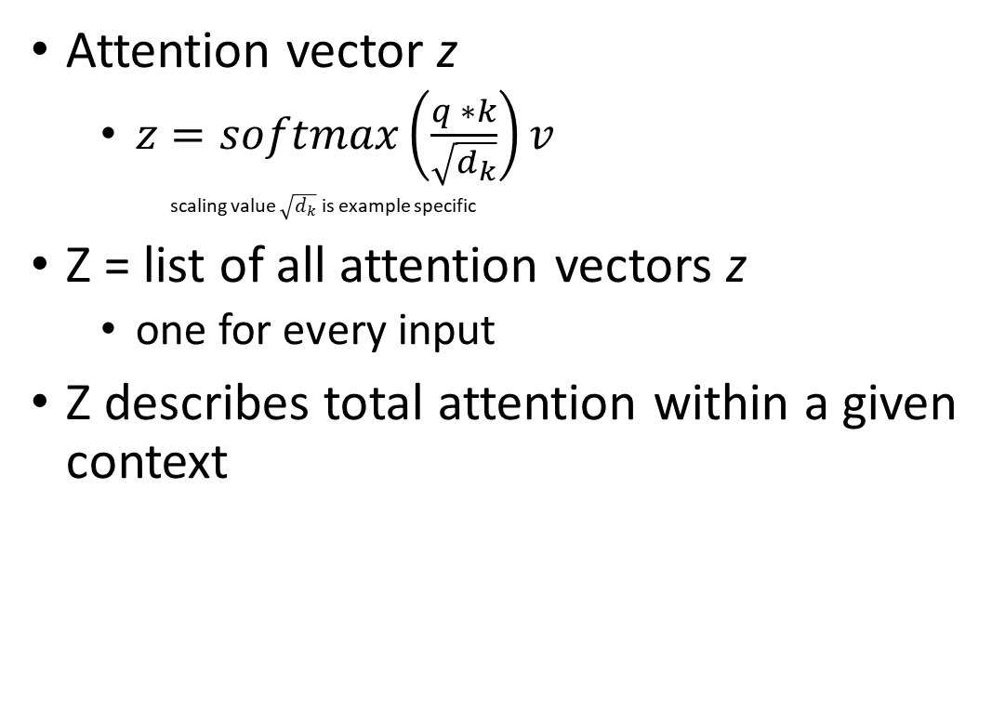
Self-Attention Via Scaled Dot Products
Getting Started
Attention vector z
$z=softmax\left(\frac{q ∗k}{\sqrt{d_{k}}}\right)v$
scaling value $\sqrt{d_{k}}$ is example specific
Z = list of all attention vectors z
one for every input
Z describes total attention within a given context
Scalar values for illustration only
(Alammar 2020)

Slide 21
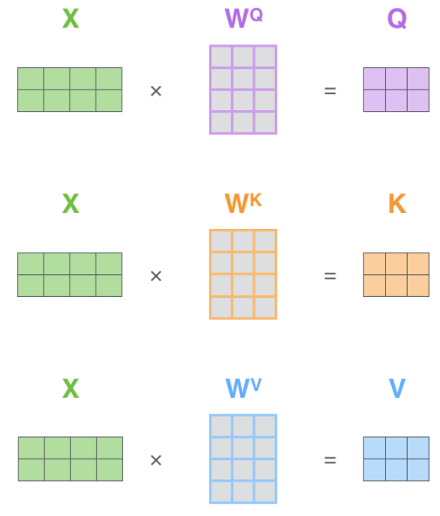
Self-Attention Via Matrix Calculation
Getting Started
If input vectors x₁, … , x_{n} are stacked into matrix X
X * W^{q} = Q
X * W^{k} = K
X * W^{v} = V
Matrices Q, K, V represent stacked q, k, v vectors
e.g. Q = q₁, … , q_{n}
(Alammar 2020)

Slide 22
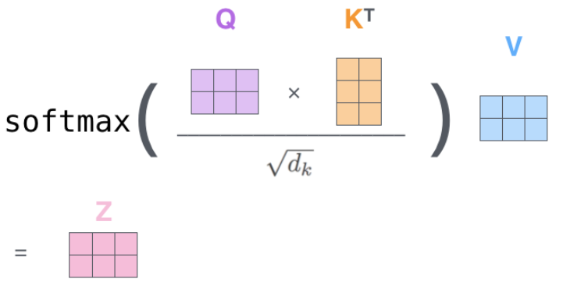
Self-Attention Via Matrix Calculation
Getting Started
Scaled Dot products can be carried out via matrix multiplication
Note transformation of matrix K
(Alammar 2020)

Slide 23
“All You Need is Attention”
Transformers
2017, Vaswani, Shazeer, Parmar, Uszkoreit, Jones, Gomez, Kaizer, Poosukhin
First introduction of Transformer model
Product of work at Google Brain and Google Research
Result of efforts to reduce sequential computation in neural networks
(Vaswani et al 2017)
(Vaswani et al 2017)

Slide 24
“All You Need is Attention”
Transformers
The following reviews the original Transformer Model
Vaswani et al 2017
Original Architecture
Original Hyperparameters
(Vaswani et al 2017)
(Vaswani et al 2017)

Slide 25
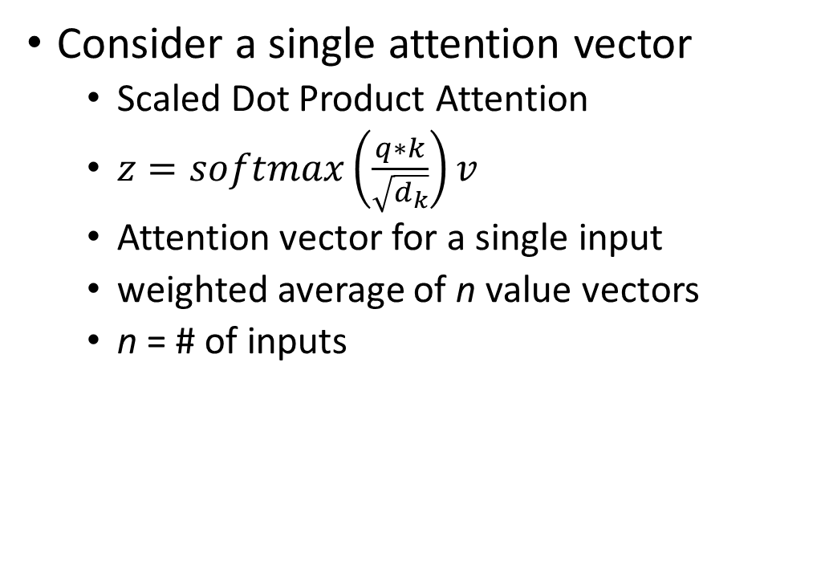
Multi-Head Attention
Transformers
Consider a single attention vector
Scaled Dot Product Attention
$z=softmax\left(\frac{q∗k}{\sqrt{d_{k}}}\right)v$
Attention vector for a single input
weighted average of n value vectors
n = # of inputs
(Alammar 2020)

Slide 26
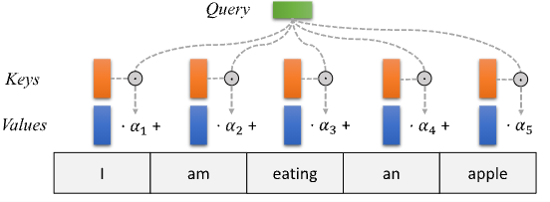
Multi-Head Attention
Transformers
“I”
Scaled Dot Product Attention
query-key pairs generate weights α
α encodes correlation between two inputs
value vectors encode information about relationship between two inputs
Attention vector z
weighted average of value vectors
Loses information through averaging
Cannot attend to multiple aspects of inter-segment correlation
e.g. subject-verb, noun-adjective, pronoun reference, etc.
z - attention vector for “I”
(Lippe 2021)

Slide 27
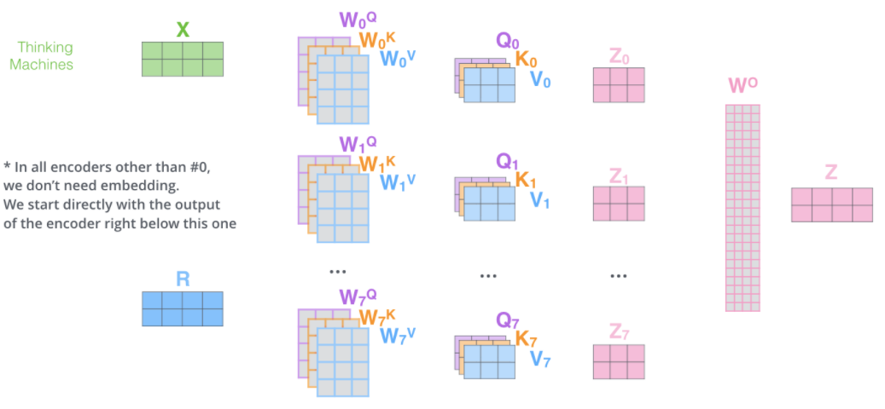
Multi-Head Attention
Transformers
Vaswani et al 2017 employed multiple attention “heads”
h = 8 heads
Each head computes scaled dot product attention
able to attend to different aspects of correlation
computed in parallel
H heads
8 heads
(Alammar 2020)

Slide 28
Multi-Head Attention
Transformers
Masks added to results of each head
Prevents Heads from attending to unwanted information (e.g. padding)
Forces large negative values that will be ignored by softmax
mask
H heads
8 heads
mask
(Wieniawska 2020)
mask
(Alammar 2020)

Slide 29

Multi-Head Attention
Transformers
Final results of each head concatenated
Multiplied by output weights Wº
Output has same dimensions as input
H heads
8 heads
(Alammar 2020)

Slide 30
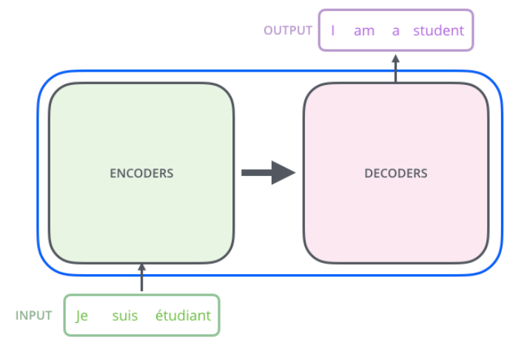
Vaswani et al Transformer
Transformers
Intermediate Encoding
Transformers use Encoder-Decoder architecture
Frequently used with RNNs, particularly LSTMs to solve sequence to sequence mapping
Very good at mapping variable length inputs to variable length outputs
Employs an intermediate encoding passed from Encoder to Decoder
(Alammar 2020)

Slide 31
Vaswani et al Transformer
Transformers
Transformers employ
N = 6 Encoder layers
N = 6 Decoder layers
The output of one Layer feeds the next
Layers must be computed in sequence
Final output of Encoder Layers passed to Decoder Layers as input
Decoder Layers
Encoder Layers
(Vaswani et al 2017)

Slide 32
Input
Transformers
All inputs must be converted to numerical vectors
d_{model} = 512
dimesnion of embedded vectors
seq_len = 512
# of input vectors
d_{model} does not need to equal seq_len
Values arbitrary
Optimized for performance/cost
Decoder Layers
Encoder Layers
(Doshi 2021)
(Dubey 2021)
(Vaswani et al 2017)

Slide 33
Input
Transformers
Input Embedding
Original model learns embeddings in training
Embeddings reused during inference
Decoder Layers
Encoder Layers
“John hit Fred”
tokenizer
“John” “hit” “Fred”
embedding layer
x₁
x₂
x₃
512
512
512
(Vaswani et al 2017)

Slide 34
Input
Transformers
Embedding Matrix:
seq_length x d_{model}
Embedding Matrix is padded
Decoder Layers
Encoder Layers
x₁
x₂
x₃
512
512
512
John x₁
Embedding
Matrix
hit x₂
Fred x₃
[PAD] x₄
…
[PAD] x_{n}
512
512
(Vaswani et al 2017)

Slide 35

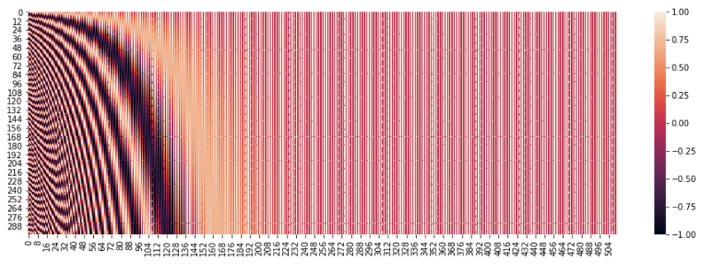
Input
Transformers
Positional Encoding
Encoding of position information
PE Matrix
Constant
Decoder Layers
(Lippe 2021)
Encoder Layers
0 dimensionality i -> d_{model}
seq_len <- pos word order 0
(Agarwal 2020)
(Vaswani et al 2017)

Slide 36
Input
Transformers
Positional Encoding
Encoding of position information
PE Matrix
Constant
Embedding Matrix + PE Matrix = Input Matrix X
Decoder Layers
(Lippe 2021)
Encoder Layers
Embedding Matrix
Input Matrix
X
512 x 512
PE Matrix
512 x 512
512 x 512
(Vaswani et al 2017)

Slide 37
Input
Transformers
Dropout
P_{drop} = .1
Randomly “drops” nodes from computation
Employed here and on sublayer output (Vaswani et al 2017)
Creates noise (Brownlee 2019)
Helps prevent overfitting (Brownlee 2019)
Decoder Layers
Encoder Layers
Dropout
Input Matrix
X
Input Matrix
X
512 x 512
512 x 512
After addition w PE Matrix and dropout, Input Matrix X will contain noise even in [PAD] positions
(Vaswani et al 2017)

Slide 38
Encoder
Transformers
2 Sub Layers
Multi-Head Attention
Feed Forward Neural Net
Inputs and outputs have dimensionality d_{model}
After each sublayer
Residual Addition
Layer Normalization
Decoder Layers
(Vaswani et al 2017)

Slide 39
Encoder
Transformers
N=6 layers
Layer Input
Layer 1
Input Matrix X (512x512)
Layer 2…6
Output of previous Layer (512x512)
Each Encoder Layer has its own weights
Decoder Layers
(Vaswani et al 2017)
d_{model} does not need to equal seq_len
Values arbitrary and optimized for performance/computational cost
(Dubey 2021)

Slide 40
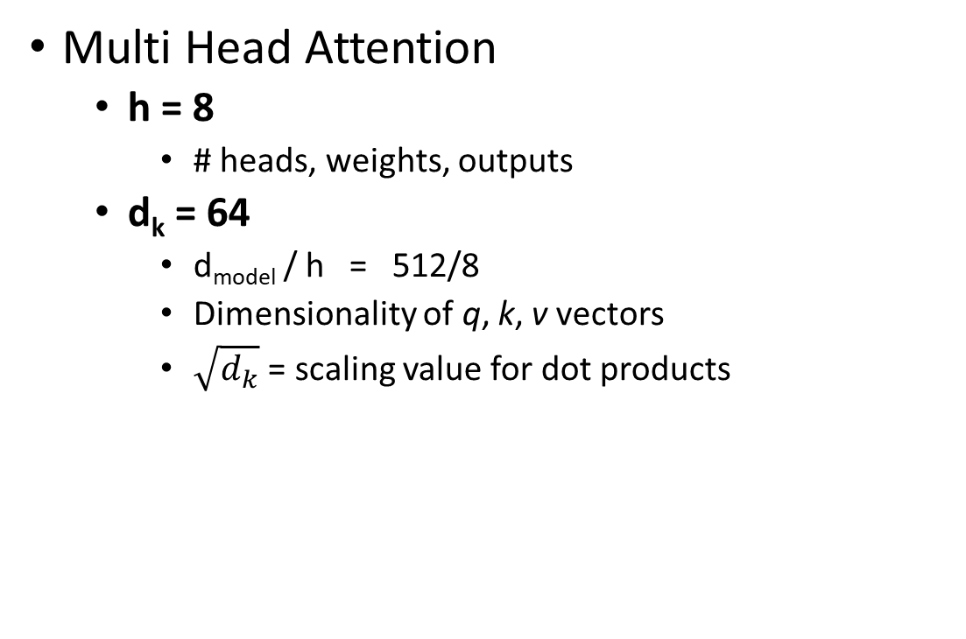
Encoder
Transformers
Multi Head Attention
h = 8
# heads, weights, outputs
d_{k} = 64
d_{model} / h = 512/8
Dimensionality of q, k, v vectors
$\sqrt{d_{k}}$ = scaling value for dot products
Decoder Layers
(Vaswani et al 2017)

Slide 41
Encoder
Transformers
Multi Head Attention Self-Attention
Decoder Layers
X
seq_len x d_{model}
Linear Layer
W^{q}
W^{k}
W^{v}
d_{model} x d_{model}
d_{model} x d_{model}
d_{model} x d_{model}
Q
K
V
seq_len x d_{model}
seq_len x d_{model}
seq_len x d_{model}
Split Head
Split Head
Split Head
seq_len x d_{k} x h
seq_len x d_{k} x h
seq_len x d_{k} x h
Linear Layer
SUBLAYER
OUTPUT
seq_len x seq_len x h
Scaling
Softmax
Concat
Z
seq_len x seq_len x h
seq_len x d_{model}
Encoder mask ignores padding
Wº
mask
seq_len x seq_len
Attention Score
(Alammar 2020)
(Vaswani et al 2017)
(Doshi 2021)
Note: Logical illustration. Does not depict required matrix transformations
Most implementations use single matrices to calculate heads simultaneously
Final linear layer Wº does not appear in all implementations
(Wieniawska 2020)

Slide 42
Encoder
Transformers
Residual Addition #1
Dropout applied to output of MHA
P_{drop} = .1
Decoder Layers
X
Multi-Head Attention
Dropout
Z_{drop}
(Vaswani et al 2017)

Slide 43
Encoder
Transformers
Residual Addition #1
Original Layer Input added to MHA output
Stabilizes training process (Versloot 2020)
Help avoid vanishing gradients (TensorFlow 2021)
Help preserve position information (need citation)
Also called a skip-connection
Decoder Layers
X
Multi-Head Attention
Dropout
Z_{drop}
X
(Vaswani et al 2017)

Slide 44
Encoder
Transformers
Layer Normalization #1
Output of MHA + Residual Normalized
mean and variance used to normalize input (Ba et al 2016)
Stabilizes training process (Versloot 2020)
Prevents values from changing too rapidly (Lynn-Evans 2018)
Helps model train faster (Lynn-Evans 2018)
Decoder Layers
X
Multi-Head Attention
Dropout
Z_{drop}
X
Layer Normalization
R
Input to Feed Forward NN
(Vaswani et al 2017)

Slide 45
Encoder
Transformers
Feed Forward NN
d_{ff} = 2048
4*d_{model} (Adaloglou 2020)
Width of hidden layers
Input/Output dimensions = seq_len x d_{model}
Operates on all ‘positions’ (Vaswani et al 2017)
i.e. all embeddings (or words in the input sequence)
2 hidden layers w ReLu activation between
Analyzes attention information in higher dimensions (Lynn=Evans 2018)
Decoder Layers
(Vaswani et al 2017)
Also called fully connected FFNNs, position wise FFNNs, linear layer(s) or dense layer(s) (Adaloglou 2020)
ReLu = Rectified Linear Unit: Activation function with floor of 0, slope never approaches 0 (Amidi, Amidi 2016)

Slide 46
Encoder
Transformers
Residual Addition & Layer Normalization #2
Dropout applied to output of FFNN P_{drop} = .1
Residual Addition
Layer Normalization
Decoder Layers
R
Feed Forward NN
Dropout
Z_{drop}
X
Layer Normalization
R₂
Input to next Encoder Layer
Or to Decoder
(Vaswani et al 2017)

Slide 47
Encoder
Transformers
Final Output
seq_len x d_{model}
Position sensitive representation of input sequence with attention data encoded
Decoder Layers
Encoder Stack
John
hit
Fred
[PAD]
…
…
[PAD]
512
512
512
512
(Vaswani et al 2017)

Slide 48
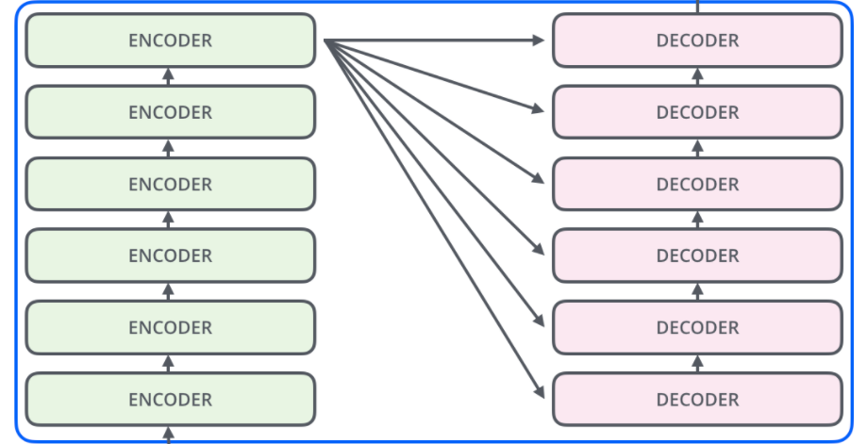
Encoder
Transformers
Final Output
Used by every Decoder layer
Decoder Layers
(Alammar 2020)
(Vaswani et al 2017)

Slide 49
Output
Transformers
Output Embedding
seq_len x d_{model}
May be different from Input Embeddings
e.g. language translation, input / output vocabularies and embeddings will be different
Training
Decoder passed target sequence
Prepended by [START] token (i.e. shifted right)
Decoder Layers
POS | Word
1 | Je
2 | Suis
3 | etudiant
[START] x₁
Je x₂
suis x₃
estudiant x₄
…
[PAD] x_{n}
512
Target
512
(Vaswani et al 2017)

Slide 50
Output
Transformers
Output Embedding
seq_len x d_{model}
May be different from Input Embeddings
e.g. language translation, input / output vocabularies and embeddings will be different
Inference
Decoder output initialized
x₁ = [START]
Or passed last Output Sequence (Doshi 2020)
Decoder Layers
(Vaswani et al 2017)

Slide 51
Output
Transformers
Positional Encoding
Added to Output Embedding Matrix
Dropout
P_{drop} = .1
Same as Encoder
Decoder Layers
(Vaswani et al 2017)

Slide 52
Decoder
Transformers
3 Sub Layers
Multi Head Self Attention
Multi Head Encoder-Decoder Attention
Feed Forward NN
Inputs / Outputs have dimensionality d_{model}
After each sublayer
Residual Addition
Layer Normalization
(Vaswani et al 2017)

Slide 53
Decoder
Transformers
N=6 layers
Layer Input
Layer 1
Input Matrix X (512x512)
Layer 2…6
Output of previous Layer (512x512)
Each Decoder Layer has its own weights
Decoder/Output Stack produces outputs 1 at a time
Decoder/Output Stack repeats until output sequence complete
(Vaswani et al 2017)

Slide 54
Decoder
Transformers
Multi Head Attention Self-Attention
X
seq_len x d_{model}
Linear Layer
W^{q}
W^{k}
W^{v}
d_{model} x d_{model}
d_{model} x d_{model}
d_{model} x d_{model}
Q
K
V
seq_len x d_{model}
seq_len x d_{model}
seq_len x d_{model}
Split Head
Split Head
Split Head
seq_len x d_{k} x h
seq_len x d_{k} x h
seq_len x d_{k} x h
Linear Layer
SUBLAYER
OUTPUT
Decoder mask prevents look-ahead
seq_len x seq_len x h
Scaling
Softmax
Concat
Z
seq_len x seq_len x h
seq_len x d_{model}
Wº
mask
seq_len x seq_len
Attention Score
(Alammar 2020)
(Vaswani et al 2017)
(Doshi 2021)
Note: Logical illustration. Does not depict required matrix transformations
Most implementations use single matrices to calculate heads simultaneously
Final linear layer Wº does not appear in all implementations
(Wieniawska 2020)

Slide 55
Decoder
Transformers
Residual Addition & Layer Normalization #1
Dropout applied to output of FFNN P_{drop} = .1
Residual Addition
Layer Normalization
X
Self Attention MHA
Dropout
Z_{drop}
X
Layer Normalization
R
Input to Encoder-Decoder Attention
(Vaswani et al 2017)

Slide 56
Decoder
Transformers
Multi Head Encoder-Decoder Attention
R
Encoder Output
seq_len x d_{model}
seq_len x d_{model}
Linear Layer
W^{q}
W^{k}
W^{v}
d_{model} x d_{model}
d_{model} x d_{model}
d_{model} x d_{model}
Q
K
V
seq_len x d_{model}
seq_len x d_{model}
seq_len x d_{model}
Split Head
Split Head
Split Head
seq_len x d_{k} x h
seq_len x d_{k} x h
seq_len x d_{k} x h
Linear Layer
SUBLAYER
OUTPUT
seq_len x seq_len x h
Scaling
Softmax
Concat
Z
Padding mask
seq_len x seq_len x h
seq_len x d_{model}
Wº
mask
seq_len x seq_len
Attention Score
(Alammar 2020)
(Vaswani et al 2017)
(Doshi 2021)
Note: Logical illustration. Does not depict required matrix transformations
Most implementations use single matrices to calculate heads simultaneously
Final linear layer Wº does not appear in all implementations
(Wieniawska 2020)

Slide 57
Decoder
Transformers
Residual Addition & Layer Normalization #2
Dropout applied to output of FFNN P_{drop} = .1
Residual Addition
Layer Normalization
R
Encoder-Decoder Attention MHA
Dropout
Z_{drop}
X
Layer Normalization
R₁
Input to Feed Forward NN
(Vaswani et al 2017)

Slide 58
Decoder
Transformers
Feed Forward NN
d_{ff} = 2048
4*d_{model} (Adaloglou 2020)
Width of hidden layers
Input/Output dimensions = seq_len x d_{model}
2 hidden layers w ReLu activation between
Same as Encoder
(Vaswani et al 2017)
Also called fully connected FFNNs, position wise FFNNs, linear layer(s) or dense layer(s) (Adaloglou 2020)
ReLu = Rectified Linear Unit: Activation function with floor of 0, slope never approaches (Amidi, Amidi 2016)

Slide 59
Decoder
Transformers
Residual Addition & Layer Normalization #3
Dropout applied to output of FFNN P_{drop} = .1
Residual Addition
Layer Normalization
R₁
Feed Forward NN
Dropout
Z_{drop}
X
Layer Normalization
R₂
Input to Next Decoder Layer
Or to final Output Linear/Softmax
(Vaswani et al 2017)

Slide 60
Output
Transformers
Output Linear Layer
Input Dimensions = seq_len x d_{model}
Output Dimension = seq_len x vocab_size (Doshi 2021)
Logits array
1 score per vocab word
Output Softmax Layer
Converts Logits to probabilities
Je | suis | etudiant | …
.75 | .05 | .1 | …
Total Output Vocabulary
(Alammar 2020)
(Vaswani et al 2017)

Slide 61
Output
Transformers
Final Output
Output = Vocab Word with highest probability
At current position
Training
Next Decoder/Output Loop begins
Until [STOP] token encountered
Loss function initiated
loss operates on final sequence of word probabilities
POS | Je | suis | etudiant | … | [STOP]
1 | 1 | 0 | 0 | … | 0
2 | 0 | 1 | 0 | … | 0
3 | 0 | 0 | 1 | … | 0
4 | 0 | 0 | 0 | … | 1
POS | Je | suis | etudiant | … | [STOP]
1 | .23 | .45 | .33 | … | .01
2 | .08 | .65 | .14 | … | .05
3 | .35 | .11 | .09 | … | .51
4 | .19 | .24 | .41 | … | .12
Target
Predicted
(Vaswani et al 2017)
In practice, Decoder can evaluate full sequence matrices at a time (Agarwal 2020)

Slide 62
Output
Transformers
Final Output
Output = Vocab Word with highest probability
At current position
Inference
Output appended to Output Sequence
Passed back to beginning of Output/Decoder stack
Until [STOP] token encountered
(Vaswani et al 2017)
Also called fully connected FFNNs, position wise FFNNs, linear layer(s) or dense layer(s) (Adaloglou 2020)
ReLu = Rectified Linear Unit: Activation function with floor of 0, slope never approaches (Amidi, Amidi 2016)

Slide 63
Training
Transformers
Batches
All training would be batched
Adds a dimension to all matrices
Teacher Forcing
Decoder fed correct outputs
Tgt sequence : “Je suis estudiant”
Decoder sequentially fed : [START], “Je”, “suis”, “estudiant”
like hints
Prevents incorrect predictions from corrupting downstream sequence
(Doshi 2020)
Greedy Decoding
Word with highest probability selected
(Alamar 2020)
Beam Search
Words with top 2 probabilities [Beam Width = 2] selected and both explored
All sequences evaluated at end of beam
(Alamar 2020)

Slide 64
Application
Transformers
Sequence to Sequence
Full Transformer Model
Automatic Translation
Document Summarization
Question Answering
Named Entity Recognition
Speech Recognition
Language Generation
Classification
Encoder Stack Only
Encoder Output fed to another model
Sentiment Analysis
Part of Speech Tagging
Word Sense Induction
Word Sense Disambiguation

Slide 65
Limitations
Transformers
Sequence Length
Quadratic Relationship with Computational Cost
(Dubey 2021)
seq_len 512 common due to this cost
Limits large text analysis
Document summarization
Question Answering
Currently under investigation
Averaging
Sparse graphs
Longformer
Transformer XL
Extending Transformer Construction

Slide 66
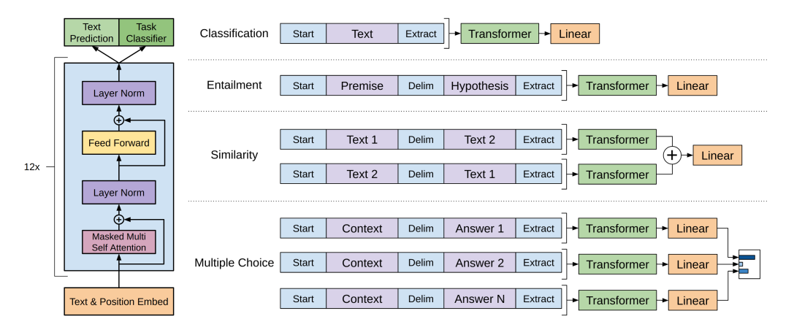
Generative Pre Trained Models (OpenAI)
GPT 2018
Unsupervised Pre-Training
N = 12 Layer Transformer Decoder
d_{model} = 768
h = 12 attention heads
D_{ff} = 3072
Seq_len = 512
Left looking attention (Left To Right)
Tasks:
Given context (u_{i-k}, … u_{i-2}, u_{i-1,}) predict u_{i}
Trained on
BooksCorpus dataset (800M words)
over 7000 unpublished books
Supervised Fine Tuning
Task specific
Transfers pre-trained learning
Adds additional output layer
Generally uses same hyperparameters
P_{drop} to classifier = .1
(Radford et al 2018)
GPT-2 2019
10 fold upscale in parameters and training data
GPT-2 XL 1.5 Billion Parameters
Open Release
GPT-3 2020
2 Orders of magnitude upscale from GPT-2
N=96, d_{model} = 12288, h=96, seq_len 2048
175 Billion Parameters
Currently under exclusive license to Microsoft
Closed Beta API available

Slide 67
Bidirectional Encoder Representations from Transformers (Google)
BERT
Unsupervised Pre-Training
Bidirectional attention (looks left &right)
Input = Sentence Pairs w Classifier
Tasks
Masked Language Model (guess words)
Next Sentence Prediction
Trained on
BooksCorpus (800M Words)
Wikipedia (2,500M Words)
Supervised Fine Tuning
Almost no architecture adjustment
(Devlin et al 2019)
Bert_{Base}
Roughly same size as GPT
N = 12 Layer Transformer
d_{model} = 768
h = 12 Attention Heads
110M Parameters
Bert_{Large}
N=24 Layer Transformer
Dmodel = 1024
h = 16 Attention Heads
340M Parameters
Both systems achieved state of the art in 11 of 11 language tasks (2019)
Bert_{Large} performed best

Slide 68
Growing Neural Gas
Introduced in 1995 by Bernd Fritzke
Extension of Neural Gas work by Thomas Martinetz and Klaus Schulten
Needs to parameters to generate clusters
Very good at learning high dimensional topology
Can conduct continuous learning on theoretically infinite data streams

Slide 69
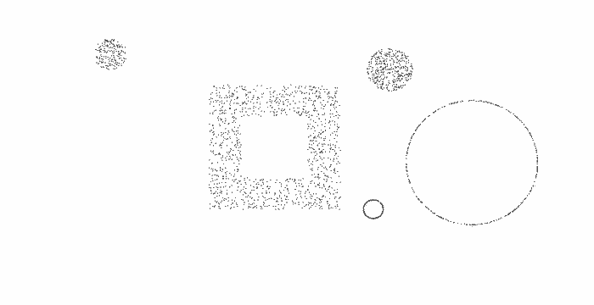
Growing Neural Gas
Set of Nodes A
Each node as a reference vector ω mapping it to input space
Each node has an accumulated error variable
Set of Edges N
Each have age
A possibly infinite set of input signals obeying an unknown density function P(ξ)

Slide 70
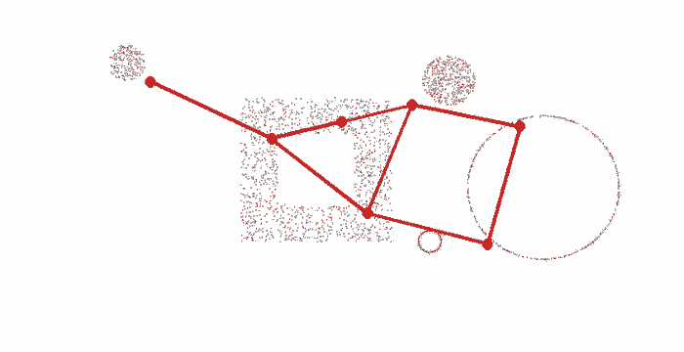
Growing Neural Gas
Begin with a random set of nodes
Select an input signal ξ according to P(ξ)
Find nearest node s₁ and next nearest s₂
Increment age of all edges emanating from s₁
Calculate squared distance between ξ and s₁ and add to total error
Δerror(s1) = ǁ ω_{s1} - ξ ǁ²
Move s₁ and direct topological neighbors ω_{n} (nodes that share an edge with s1) toward ξ by fractional distances ϵ_{b} ,ϵ_{n}
Δ ω_{s1} = ϵ_{b}(ξ - ω_{s1})
Δ ω_{n} = ϵ_{n}(ξ - ω_{n})
If s₁ and s₂ share an edge, set its age to zero. Create edge if it does not exist

Slide 71
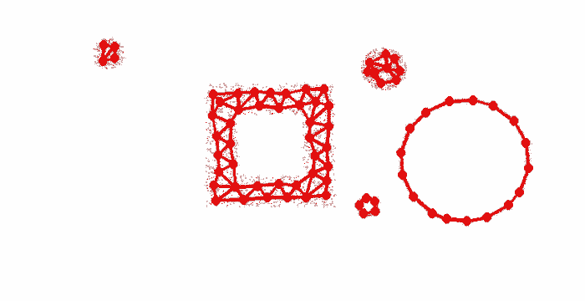
Growing Neural Gas
Remove edges with age > age_{max}
Remove nodes with no edges
If input signals processed is an integer multiple of parameter λ,
Find unit q with maximum error
Find unit f, topological neighbor of q with next highest error
Insert new unit r halfway between q and f
ω_{r} = 0.5(ω_{q} - ω_{f})
Insert new edges r-q, r-f
Remove existing edge q-f
Decrease error of f and q by multiplying with parameter α
Set error of r = error of q
Decrease all unit errors by multiplying with parameter d
Check for stopping criteria

Slide 72
Why WSI/WSD
Improve Named Entity Recognition
Improve Natural Language Understanding
Improve information summarization and information search
Enable fine grained Sentiment Analysis
Enable social group classification
ID Social Group participation
Age
Etc
Figure out what we’re really talking about
Observe Language Change
Rebuild WordNet
Hyper/hyponym relations
As a vehicle for linguistic research

Slide 73
Why WSI/WSD
What do we need to know
Need to know what we’re talking about
Need a way (without tagged resources) to say something about the way a word is used in a particular context
Also need a way to provide a gloss of that word in that context

Slide 74
How do we study WSI
When things go wrong (i.e. pertubations)
Put words we know are wrong and use that as a competitive factor
No way to determine a sense inventory
Senses constantly changing
Historical change
In-out group change
Gold Standard senses, low inter-0=per agreement
Maybe they would have tagged different with different sense inventory
Maybe the way I use other words influences how I use a target word
What are things that NLP already does well? (NER, POS)
How the fuck do I figure out what “I’m going to beach it” means

Slide 75
BERT
BERT know a lot of shit
But like humans, it doesn’t necessarily know what it knows
And its hard to figure out how to probe that
We have to essentially ask Bert Questions in the general form of “Hey Bert, is this well formed?”
Bert can generate syntactically well formed text
Not necessarily sematically well formed
Bert BASED on writing
Only a matter of time until someone points BERT at a Corpus of transcribed speech
The computing power to do so rests w large corporations
By training on amazingly large bodies of text BERT is able to make surprisingly lucid semantic judgements
But of course there is not discrete semantic knowledge behind it
We can inform our applications by increasing discrete semantic knowledge
BERT may be able to assist in making “well formed” statement judgements
Alleviating need for human review
BERT is a linguistic mirror
BERT is able to do what computer’s do best, consume unfathomable amounts of data
BERT tells us things about things that we’ve told it
BERT would be so much cooler if it was pointed at a single human’s production

Slide 76
How do we study WSI
What if we just take the embedding of every occurrence of a word and run it against a neural gas model to find vertices, etc.
As an alternative to clustering
Number of clusters does not need to be specified in advance!
BERT & NEURAL GAS!
Or Self Organizing Feature Maps
Start with the word (logograph)
It’s the one thing we know about with certainty
BERT creates position & context encoded representations of words in context
We take a bunch of these for a given word and run neural gas against it
We compare # of clusters against word net
NO TRAINING NECESSARY ON LANGUAGE SIDE
Just the GNG operation

Slide 77
Vaswani et al Transformer
Transformers
d_{model} = 512
N=6
h=8
d_{k} = d_{model} / h = 64
d_{v} = 64
d_{ff} = 2048
P_{drop} = .1
E_{ls} = .1
Train steps = 100K
65M Parameters
seq_len = 512
(Vaswani et al 2017)
(Vaswani et al 2017)

Slide 78
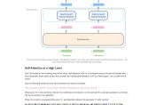
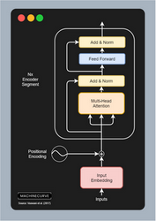





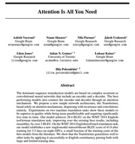
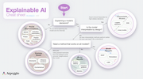




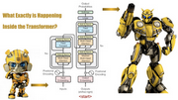



A limitation of existing Transformer models and their derivatives, however, is that the full self-attention mechanism has computational and memory requirements that are quadratic with the input sequence length. With commonly available current hardware and model sizes, this typically limits the input sequence to roughly 512 tokens, and prevents Transformers from being directly applicable to tasks that require larger context, like question answering, document summarization or genome fragment classification.
googleblog.com
The Illustrated Word2vec – Jay Alammar – Visualizing machine learning one concept at a time.
github.io
Transformers for Machine Learning: A Simple Explanation | by François St-Amant | Towards Data S
towardsdatascience.com
What Exactly Is Happening Inside the Transformer | by Huangwei Wieniawska | The Startup | Medium
medium.com
The Illustrated Transformer – Jay Alammar – Visualizing machine learning one concept at a ti
github.io
Machine Learning for Transformers - Explained with Language Translation - DeepLobe
deeplobe.ai
How Transformers work in deep learning and NLP: an intuitive introduction | AI Summer
theaisummer.com
Transformers Explained Visually (Part 3): Multi-head Attention, deep dive | by Ketan Doshi | Tow
towardsdatascience.com
Transformers Explained Visually (Part 1): Overview of Functionality | by Ketan Doshi | Towards D
towardsdatascience.com
Transformer model for language understanding | Text | TensorFlow
tensorflow.org
Introduction to Transformers in Machine Learning – MachineCurve
machinecurve.com
Jay Alammar – Visualizing machine learning one concept at a time.
github.io
CS480/680 Lecture 19: Attention and Transformer Networks
youtube.com
For every word, we have one key and one value vector. The query is compared to all keys with a score function (in this case the dot product) to determine the weights. The softmax is not visualized for simplicity. Finally, the value vectors of all words are averaged using the attention weights.
readthedocs.io
pytorch-pretrained-bert · PyPI
pypi.org
How to code The Transformer in PyTorch
floydhub.com
1810.04805.pdf
arxiv.org
1706.03762.pdf
arxiv.org
The Annotated Transformer
harvard.edu
kdnuggets.com
This means that separate sections of the Embedding can learn different aspects of the meanings of each word, as it relates to other words in the sequence. This allows the Transformer to capture richer interpretations of the sequence.
towardsdatascience.com
Actually, there is usually an upper bound for inputs of transformers, due to the inability of handling long-sequence. Usually, the value is set as 512 or 1024 at current stage.
stackexchange.com

